Slide 1
Airline Safety-Executive summary
-Meena Madhavi Gummadi

Slide 2
contents
Introduction
Airline Revenue
Airline Fatalities
Airline Incidents
Airline Hijackings
Top 5 Airline Incidents
Total airline crashes
Auto deaths vs Airline deaths
conclusion

Slide 3
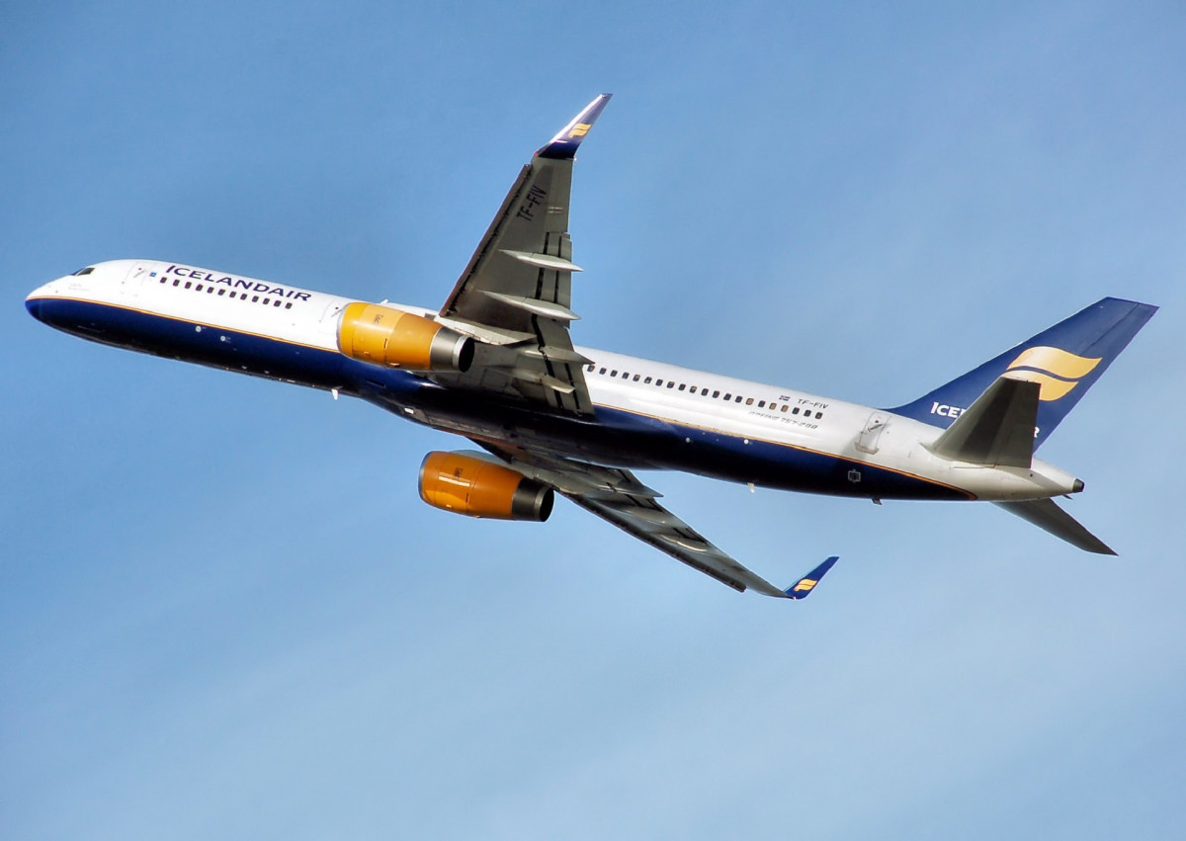
Introduction
Airline passengers may feel strongly about airline safety, so we think they should receive 100% accuracy. Any single, comprehensive measurement of airline safety must offer precisely that - a single rating format without any gaps due to variations in how safety incidents may or may not be reported.

Slide 4
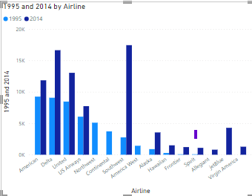
Airline revenue 1995 vs 2014
The graph depicts that airline revenue has drastically increased from 1995 to 2014, which means the number of passengers has increased from 1995 to 2014. This indicates that people are believing airline travel is safe and comfortable.

Slide 5
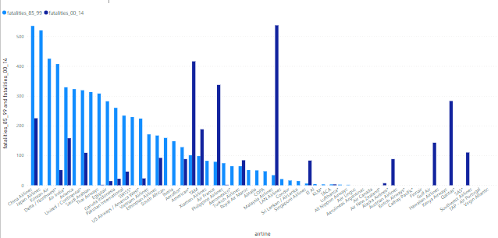
Airline fatalities
The graph displays the number of airline fatalities from 1985 to 1999 and from 2000 to 2014. Since there is no harm to the passenger health, in the 2000 period new airlines got started and running successfully. Over the following period, the airlines with the highest fatality rates have decreased gradually and showing successful travel history.

Slide 6
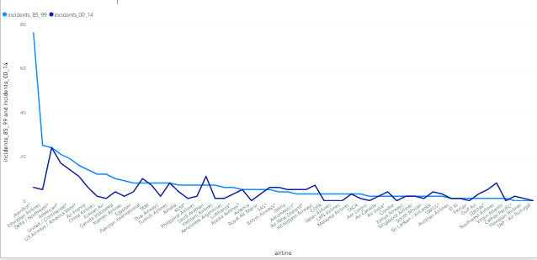
Airline Incidents
The statistics shows the trend for each airline incidents over two time periods (1985- 1999 and 2000-2014). We can observe that the incidents got drastically reduced. The most incidents were reported by Aeroflot Airlines (76) between the years of 1985 and 1999, and only 6 between the years of 2000 and 2014. The number of incidents reported all other airlines are very minimal and it shows air travel is safe.

Slide 7
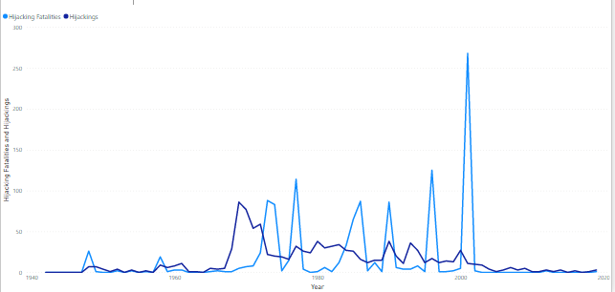
Airline hijack
The graph for fatalities and hijackings shows how both numbers dramatically decreased after the 9/11 terrorist attack in 2001. This demonstrates that over the last 20 years, flying has gotten safer.

Slide 8
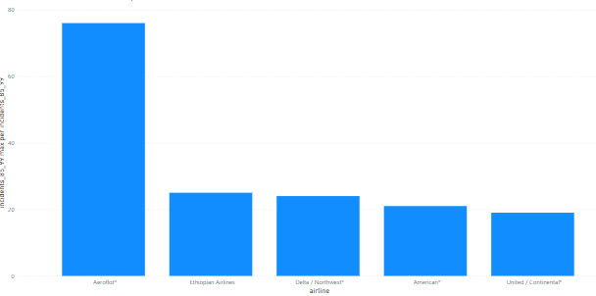
Top airline incidents
The most reports came from Aeroflot, then Ethiopian Airlines. Which airlines are the worst offenders is abundantly clear from the updated data. Some of the media reports may be made clearer by these graphs. When they release raw data, US carriers come across as dangerous. When adjusted for ASK, they are demonstrated to be significantly safer.

Slide 9
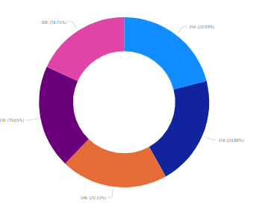
Airline crashes
By examining the percentage of crashes in the graph over the past few years, the number has decreased, demonstrating the safety of air travel.

Slide 10
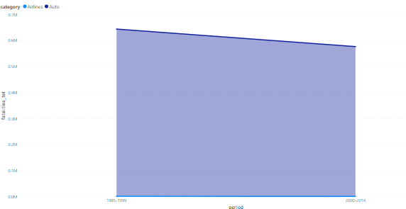
Auto vs airline deaths
The graph displays all deaths, including those of airline passengers, over the two time periods of 85-99 and 00-14. The graph shows that there are more auto fatalities than there are fatalities from airlines.

Slide 11
Conclusion
Most travelers who are familiar with the airline industry think that flying is safe. But when something unusual happens that we can't explain, any of us may become frightened very quickly.
All the statistics shows that airline travel still safer and can be considered without any doubt.
Despite a fifty percent increase in passengers during the past ten years, there was a forty percent decrease in the number of fatal accidents and a twenty-five percent decrease in the number of fatalities, according to accident statistics provided by the National Transportation Safety Board.

